Slide 1
Propositional Logic
Fall 2023

Slide 2
Implication
p → q weird truth table
what is it
how do we interpret it

Slide 3
Implication
p → q is read “if p then q”
p = “it is raining”
q = “Pat carries an umbrella”
p→q is like an observation or assertion about the world, something we claim holds
p → q weird truth table
what is it
how do we interpret it

Slide 4
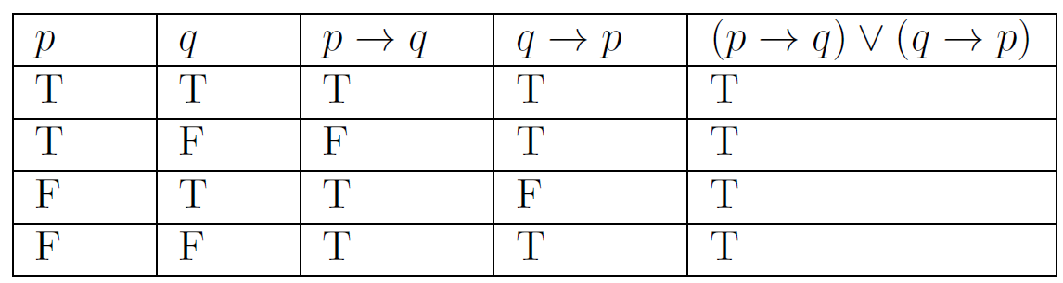
Implication
p → q is read “if p then q”
p = “it is raining”
q = “Pat carries an umbrella”
p→q is like an observation or assertion about the world, something we claim holds
p → q weird truth table
what is it
how do we interpret it
{
Possible worlds:
whether or not it is raining
whether or not Pat is carrying an umbrella

Slide 5
Implication
p → q is read “if p then q”
p = “it is raining”
q = “Pat carries an umbrella”
p→q is like an observation or assertion about the world, something we claim holds
p → q weird truth table
what is it
how do we interpret it
Does the assertion hold when the world looks like this?

Slide 6
Implication
p → q is read “if p then q”
p = “it is raining”
q = “Pat carries an umbrella”
p→q is like an observation or assertion about the world, something we claim holds
p → q weird truth table
what is it
how do we interpret it
Does the assertion hold when the world looks like this?

Slide 7
Implication
p → q is read “if p then q”
p = “it is raining”
q = “Pat carries an umbrella”
p→q is like an observation or assertion about the world, something we claim holds
p → q weird truth table
what is it
how do we interpret it
Does the assertion hold when the world looks like this?

Slide 8
Implication
p → q is read “if p then q”
p = “it is raining”
q = “Pat carries an umbrella”
p→q is like an observation or assertion about the world, something we claim holds
p → q weird truth table
what is it
how do we interpret it
Does the assertion hold when the world looks like this?
p is the premise. When the premise if false, the assertion is true

Slide 9
Implication
p → q is read “if p then q”
p = “it is raining”
q = “Pat carries an umbrella”
p→q is like an observation or assertion about the world, something we claim holds
p → q weird truth table
what is it
how do we interpret it
Does the assertion hold when the world looks like this?

Slide 10
Tautology
A tautology is a compound proposition that is always true
Definition 1 from Section 1.3.1
Which of the following compound propositions are tautologies?
p ∨ ¬p
p ∨ q
(p→q) ∨ (q→p)

Slide 11
Tautology
A tautology is a compound proposition that is always true
Definition 1 from Section 1.3.1
Which of the following compound propositions are tautologies?
p ∨ ¬p
p ∨ q
(p→q) ∨ (q→p)

Slide 12
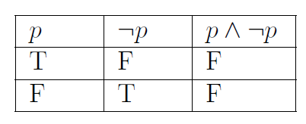
Contradiction
A contradiction is a compound proposition that is always false
Definition 1 from Section 1.3.1
Is the following compound proposition a contradiction?
p ∧ ¬p

Slide 13
Logical Equivalence
Compound propositions p and q are called logically equivalent if p ↔ q is a tautology (Definition 2, from Section 1.3.2)
p ↔︎ q
p = …
q = …
a
b
c
d

Slide 14

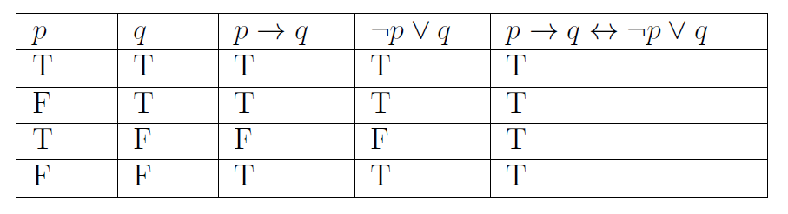
Logical Equivalence
Compound propositions p and q are called logically equivalent if p ↔ q is a tautology (Definition 2, from Section 1.3.2)
We denote that p and q are called logically equivalent by p ≡ q
Example, conditional-disjunction equivalence:
✓

